Slide 1
Week 3 Wimba

Slide 2
Contact Information
Email: rgroffalarcon@fullsail.com
iChat: rgroffalarcon@aim.com
Text: 407-900-0648
PLEASE be sure to identify yourself.
Office Phone Number: 407-679-0100 x4151

Slide 3
Project 2
Bare Minimum – 2 apps, the Bronze MUST contain a fully functioning CRUD!
JQM on everything
Missing week 1 requirements:
Missing or unattractive Feature/CTA.
Missing value proposition.
Browse Categories are missing.
Search is missing.

Slide 4
Project 2
Search:
Non-functioning
data-filter=“true”
Navigation:
Present, but non-functioning
Not consistent
Only on one app, should be on both
Does not include HOME, INFO or ABOUT, NEWS, etc.

Slide 5
Project 2
Item Details:
One-Window Drilldown AND List Inlay were required.
Images:
Missing or oddly formatted Thumbnail Grid
Thumbnail Grid, use <br/> to force text to the line below the image.
Thumbnail & Text missing
Order:
Missing

Slide 6
Project 2
Organization:
While HTML files do not belong in a folder, there should only be 2 html file – index and additem
JQM is specifically designed so that all pages are in one file. **
Git Issues:
Links not included
Branches are not in sync**

Slide 7
Project 2
JQM should NOT be added to the VFW CRUD form and never to the JSON. That’s why the CRUD stopped working.
Getting ahead of yourself.
Not asking questions until Thursday.
Pages not linking to anything:
Many of the pages were linked to # as placeholders.
Pages are calling non-existing pages.
Form Elements:
You must have a functioning CRUD in your Bronze app.

Slide 8
Project 3

Slide 9
Form Basics (pgs 341 – 343)
Make sure the user understands what’s being asked for and why.
Avoid asking questions:
Autocompletion
Input Prompts
Good Defaults
Notes:
Use labels, plain language for novice or occasional users, carefully chosen jargon or specialized vocab for domain experts.

Slide 10
Form Basics (pgs 341 – 343)
Provide lists from which the user can make choices.
Dropdown Chooser
Combo boxes
Lists
Good Defaults
Input Hints

Slide 11
Form Basics (pgs 341 – 343)
Let the programming dictate the base form.
Usability test-it – Think the old adage, “…can’t see the forest for the trees.”
Your choice of controls will affect the user’s expectations of what is asked for, choose wisely!

Slide 12
Goal and Page Conversions
What do you want the user to do?
Prominent “Done” Buttons
Submit
Done
Send
Buy
Change Record
Luke Wroblewski http://www.lukew.com

Slide 13
Use forms to mistake proof the completion process.
Provide direction
Ensure you receive the desired response
Will ensure that the database receives the format required to complete the task
See pages 345 – 355 for ideas

Slide 14
Poka Yoke Approach
“Japanese approach to 'mistake proofin’ in all aspects of manufacturing, customer service, procurement, etc. It employs visual signals that make mistakes clearly stand out from the rest, or devices that stop an assembly line or process if a part or step is missed. Its older name is baka yoke (fool proofing).”
http://www.businessdictionary.com/definition/poka-yoke.html
Notes:
Project 3: Modifying the create and update pages of your CRUD app to support a Poka Yoke approach to form design, using this weeks design patterns.

Slide 15
Poka Yoke Approach
From Wikipedia, the free encyclopedia Poka-yoke (ポカヨケ?)
“Poka-yoke [poka yo-ke] is a Japanese term that means ‘fail-safing’ or ‘mistake-proofing’.”
http://en.wikipedia.org/wiki/Poka-yoke
Notes:
Project 3: Modifying the create and update pages of your CRUD app to support a Poka Yoke approach to form design, using this weeks design patterns.

Slide 17
Project 3 Requirements
You have must 2 DIFFERENT Forms:
GOLD - MUST be pure JQM
BRONZE - MUST be your VFW fully functioning CRUD
If you do not have this, you WILL receive a ZERO!
Form Selections: (You must have 2)
Input Hints (pgs 364 -368)*
Input Prompts (pgs 369 – 371)*
Dropdown Chooser (pgs 380 – 383)

Slide 18
Project 3 Requirements
Good Defaults (pgs 385 – 387):
Range slider
Date-field
Checkbox elements
Prominent Done Button (pgs 257 – 261)
Same-Page Error Messages (pgs 388 – 391)

Slide 19
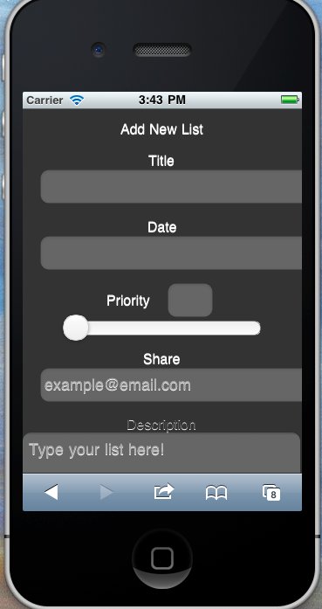
Input Hints (pgs 364 – 368)
Text that is beside or below an empty text field that explains what is required.
Notes:
Brandon

Slide 20
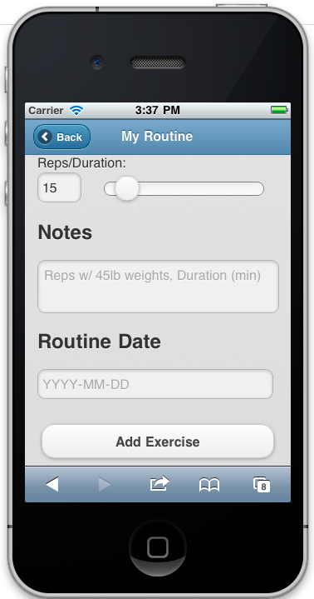
Input Prompts (pgs 369 – 371)
A text field or drop down with a prefilled prompt that tells the user what to do or type.
Notes:
Rueben

Slide 21
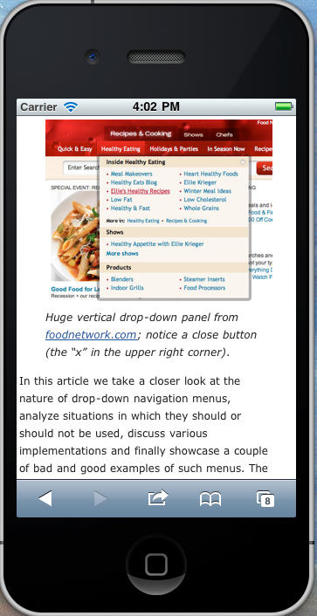
Dropdown Chooser (pgs 380 – 383)
Use a dropdown or pop-up panel to contain more complex UI value selections.
These can include calendars and time choosers.
Notes:
Smashing

Slide 22
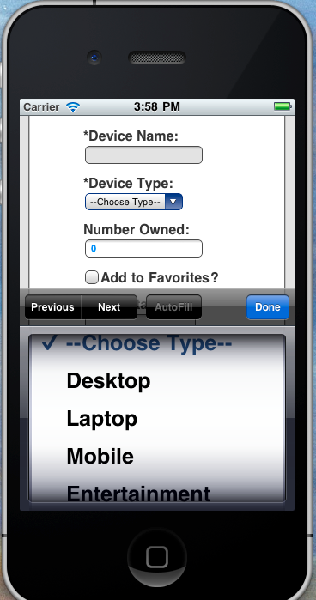
Dropdown Chooser (pgs 380 – 383)
I will accept a spinner as the fulfillment of dropdown; however, remember that the drawback is that you typically do not see all of the selections in one screen.
Notes:
Mike

Slide 23
Good Defaults (pgs 385 – 387)
These should be appropriate, your best guess as to what the user will enter.
Notes:
Rueben

Slide 24
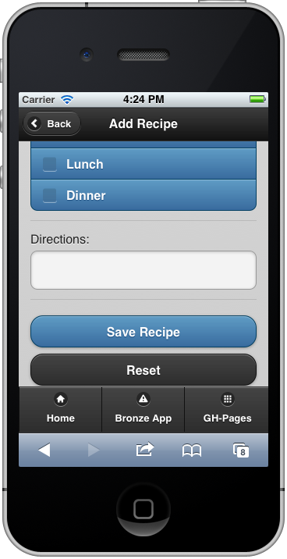
Prominent Done Button (pgs 257 – 261)
Should be at the end of the visual flow and away from secondary actions.
CAUTION: Mike Smotherman is an amazing programmer and produces wonderful videos; however, he is NOT a UI expert. Please follow his video for code and NOT for placement of your buttons.
Notes:
Ryan

Slide 25
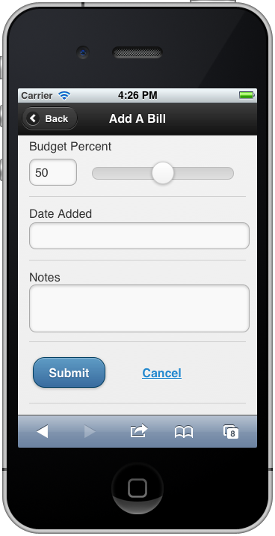
Prominent Done Button (pgs 257 – 261)
Should be at the end of the visual flow and away from secondary actions.
Notes:
Ryan

Slide 26
Changes to Main.js
Start with a NEW Main.js
The Video shows:
$(document).ready(){
};
The jquerymobile site shows:
$(document).bind(‘pageinit’, function(){
};
Notes:
Ryan

Slide 27
To prepare for jQuery in ASD:
$('#addItem').on('pageinit', function(){
var myForm = $('#formId');
myForm.validate({
invalidHandler: function(form, validator) {
},
submitHandler: function() {
var data = myForm.serializeArray();
storeData(data);
}
});
Notes:
Ryan

Slide 28
Main (cont.)…
I will send a sample-main.js template to you. Please set you Main up to follow this, even if part of it remain blank until ASD!

Slide 29
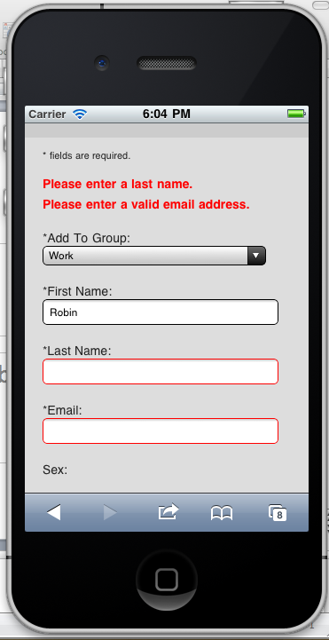
Same Page Error Messages (pgs 388 – 391)
Should be at the top of the page with indicators on the fields. BE GENTLE!

Slide 30
Deliverables
Two live links to your code:
Repository at GitHub
Working live (clickable) link to the project source code (from your master branch) on GitHub.com
Live code at GitHub
Working live (clickable) link to the live code (from your gh-pages branch) on GitHub.com

Slide 31
Deliverables (cont.)
Two apps:
Your “GOLD” app. – validate and save only
This is your JQM app and should be the one that you feel is the most usable.
Your “BRONZE” app – must be fully functioning.
This is the app in which you apply utilize your VFW CRUD and has patterns that you are not certain work for your app.

Slide 32
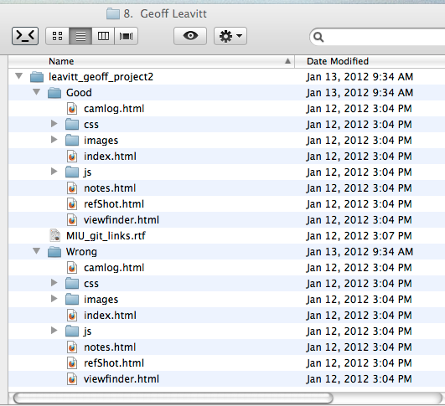
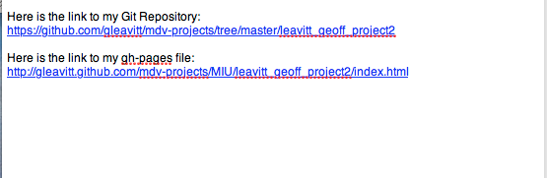
Deliverables (cont.)
File Naming
Clickable Files

Slide 33
Possible issues…

Slide 34
Project 4

Slide 35
What’s coming up? Project 4
Visual Enhancements
Few Hues, Many Values
Deep Background
Streamlined Branding
Everything Else from weeks 1-3
Search
Navigation
Newsstream or Filmstrip
Everything working

